Slide 1
Tag Attachment Methods

Slide 2
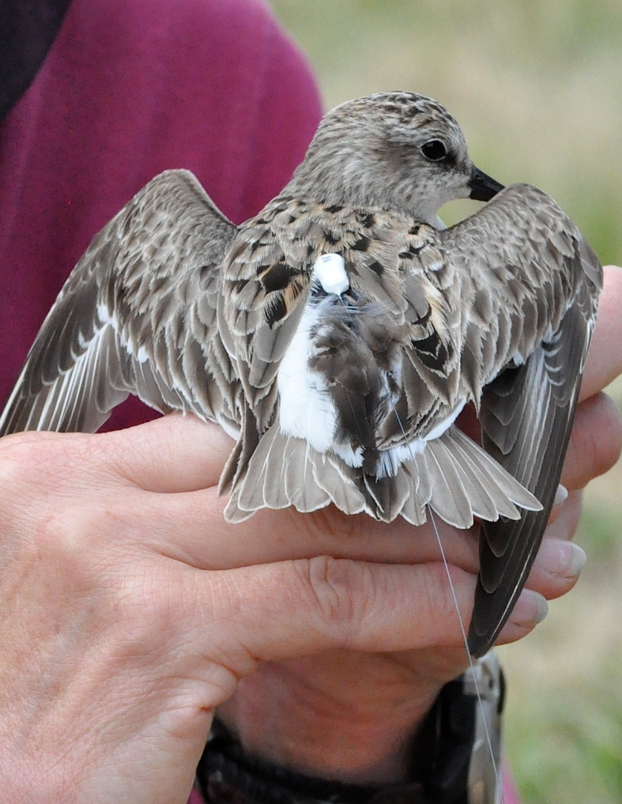
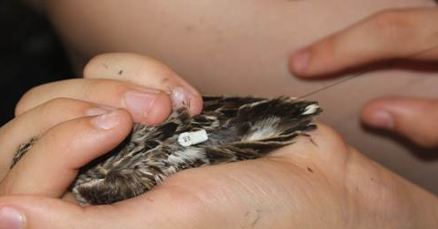
Gluing tags to birds – Holberton & Tudor
© R. Holberton
© D. Hamilton

Slide 3
Gluing tags to bats – Peterson
1: trim small patch of fur between scapulae using trimming scissors (disinfect)
2: Apply thin coat of surgical glue (SkinBond) to tag.
3: Apply thin layer of glue to exposed patch of skin and wrap surrounding hair over tag, allowing antenna to trail straight behind bat.
4: hold for about ~5 minutes to ensure glue sets and tag attaches.
5: disinfect all tools/materials used according to WNS decontamination guidelines before handling another bat.

Slide 4
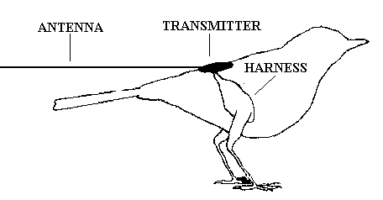
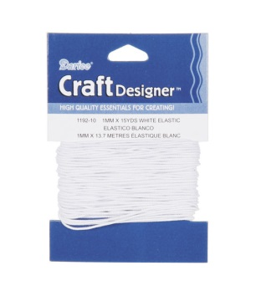
Leg Loop harnesses - Smetzer
(Rappole and Tipton 1991)
Longer tag retention
MINIMAL glue- tag can come off eventually
Recaps did not exhibit abrasion or injury
Materials:
Elastic 1mm thread, like for bracelet making, and loctite super glue
Sizing:
published dimensions for leg loops (Naef-Daenzer 2007)
trial– record mass/size for good fits
Have a few sizes available each day
Deploying
http://www.holohil.com/rappole.htm
Check that the feet are perching, wings are free, up over very top of leg- reassess
4mm
35mm
4mm
4mm

Slide 5
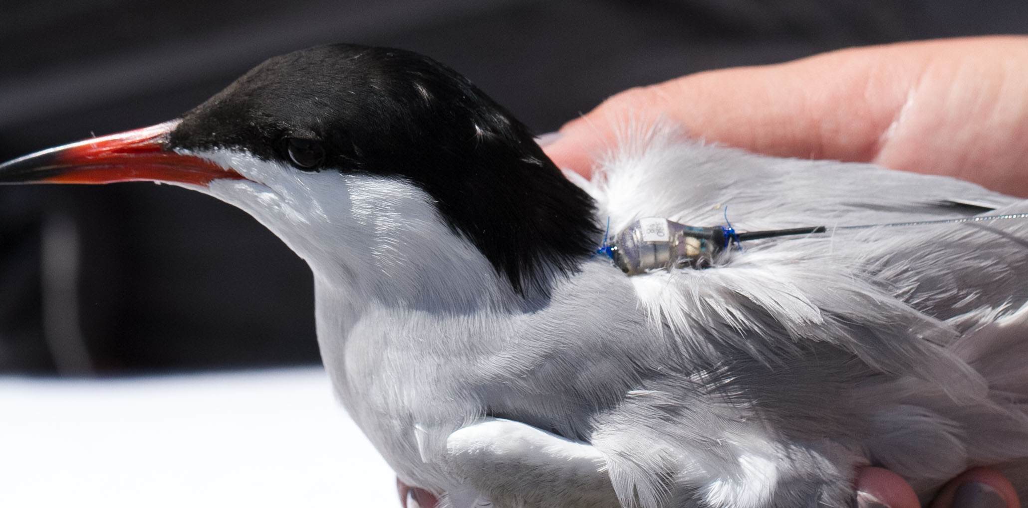
Suture and Glue Tag Attachment for Terns
P. Paton
Pam Loring – UMass Amherst

Slide 6
Materials
Ethicon Prolene
Size 4-0, taper point, 3/8 circle, 30"
Expired (non-sterile) less expensive
Q-tips and isopropyl alcohol
Needle drivers (2), scissors (1) – ask for donations
Adhesive (Loctite 422, Loctite Gel Epoxy 6 min dry time, others?)
Sharps container
For the bird: pillow, head cone, person to hold

Slide 7
Process
Rest bird on pillow, head in cone
Minimize talking to reduce bird stress & movement
Little blood supply between feather tracks
Apply alcohol with Q-tip to part feathers and check position
Use fingers to tent skin and needle drivers to insert sutures (top and bottom)
Tie off with surgeons knot & 3 square knots. Tension on 1st throw most important. Make sure knots lie flat (not twisted).
Apply glue to underside of tag and to each knot and hold still until dry

Slide 8
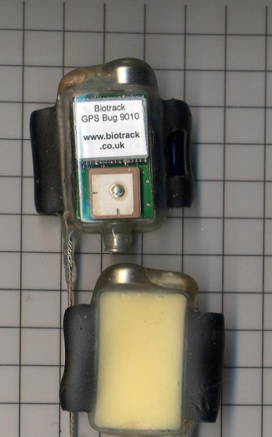
Custom Attachment Tubes
2014
2013

Slide 9
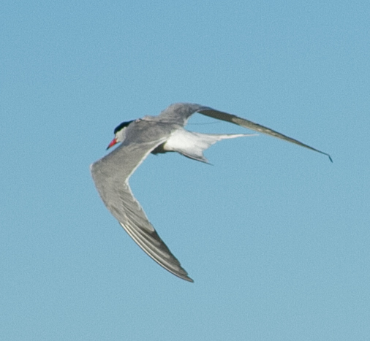
Acknowledgements
Linda Welch (Maine Coastal Islands NWR)
Rob Ronconi (Acadia University)
Mark Pokras, DVM (Tufts University)
Lynn Miller (Cape Wildlife Center)
Kate Iaquinto (Monomoy NWR)
Norm Smith (Mass Audubon)
Carolyn Mostello (MA Natural Heritage Program)
Mike Vandentillaart (Lotek Wireless)
P. Paton

Slide 10
Power Minimizing Strategies with PV

Slide 11
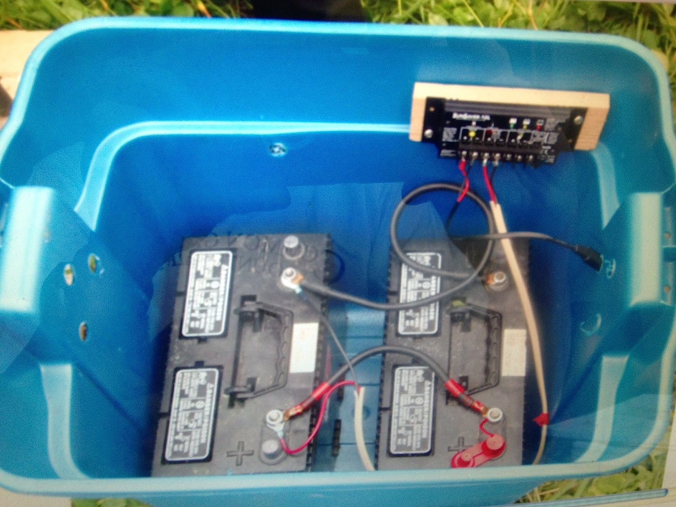
Holberton
To PV

